Slide 1

ML/AI for Prediction of Physician and Laboratory Diagnostic Testing
Presented by : Anjum Banu Ismail MSc. Data Analytics | Academic Supervisor: Dr. Laura Boyle Queen’s University Belfast | Company Supervisor: Scott Morrison Diaceutics PLC

Slide 2
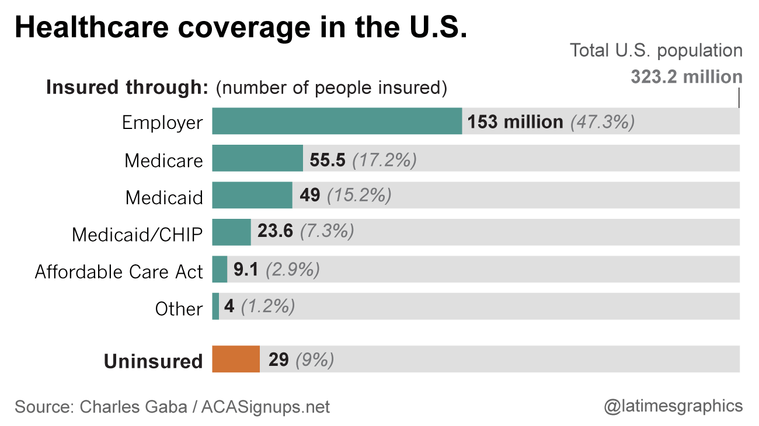
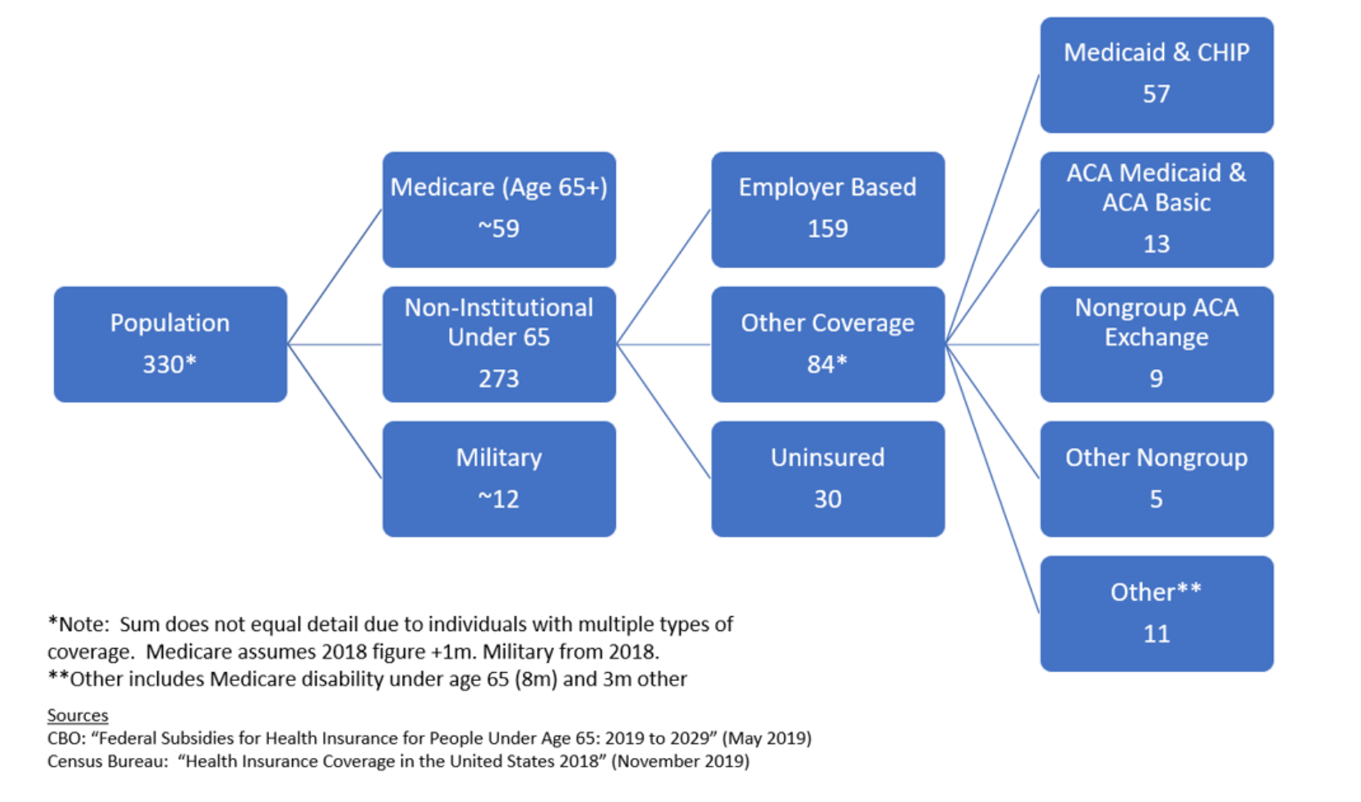
Background
Health insurance in the United States is any program that helps pay for medical expenses, whether through privately purchased insurance, social insurance, or a social welfare program funded by the government.
This usage includes both private insurance programs and social insurance programs such as Medicare
Medicare is a federally administered insurance program that Americans pay into throughout our working lives and enrol in after they retire or in case of a serious disability.
Commercial insurance is required to protect its business interests by avoiding those most likely to use medical care by providing it for people below 65.

Slide 3
Problem Statement
Year | Lab |  | Physician
 | Medicare | Commercial | Medicare | Commercial
2017 | Q1 | Q1 | Q1 | Q1
 | Q2 | Q2 | Q2 | Q2
 | Q3 | Q3 | Q3 | Q3
 | Q4 | Q4 | Q4 | Q4
2017 | Q1 | Q1 | Q1 | Q1
 | Q2 | Q2 | Q2 | Q2
 | Q3 | Q3 | Q3 | Q3
 | Q4 | Q4 | Q4 | Q4
2018 | Q1 | Q1 | Q1 | Q1
 | Q2 | Q2 | Q2 | Q2
 | Q3 | Q3 | Q3 | Q3
 | Q4 | Q4 | Q4 | Q4
2019 | Q1 | Q1 | Q1 | Q1
 | Q2 | Q2 | Q2 | Q2
 | Q3 | Q3 | Q3 | Q3
 | Q4 | Q4 | Q4 | Q4
2020 | Q1 | Q1 | Q1 | Q1
 | Q2 | Q2 | Q2 | Q2
 | Q3 | Q3 | Q3 | Q3
 | Q4 | Q4 | Q4 | Q4
2021 | Q1 | Q1 | Q1 | Q1
 | Missing | Q2 | Missing | Q2
 | Missing | Q3 | Missing | Q3
We have volumes of Malignant Lung Cancer patient reported every quarter by Physicians (Orders for testing) and Labs (Performs the testing) from year 2017 to 2021.
The Commercial data is always a lot more up-to-date than the Medicare data.
We answer the following questions through this project:
How to make consistent Patients volume predictions across the Medicare care using its past volumes and updated volumes of Commercial data for every ID?
Which time series model is the best for an aggregation level?
Which methodology is better for the forecast of our problem — and why?

Slide 4




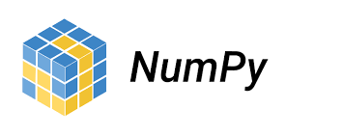








Data Science Pipeline and Tools Used
Forecasting
Deployment

Slide 5
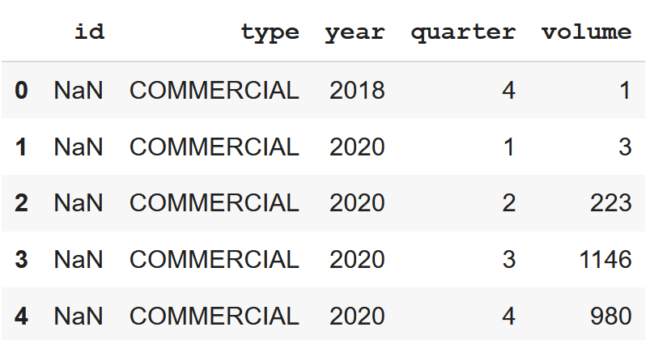
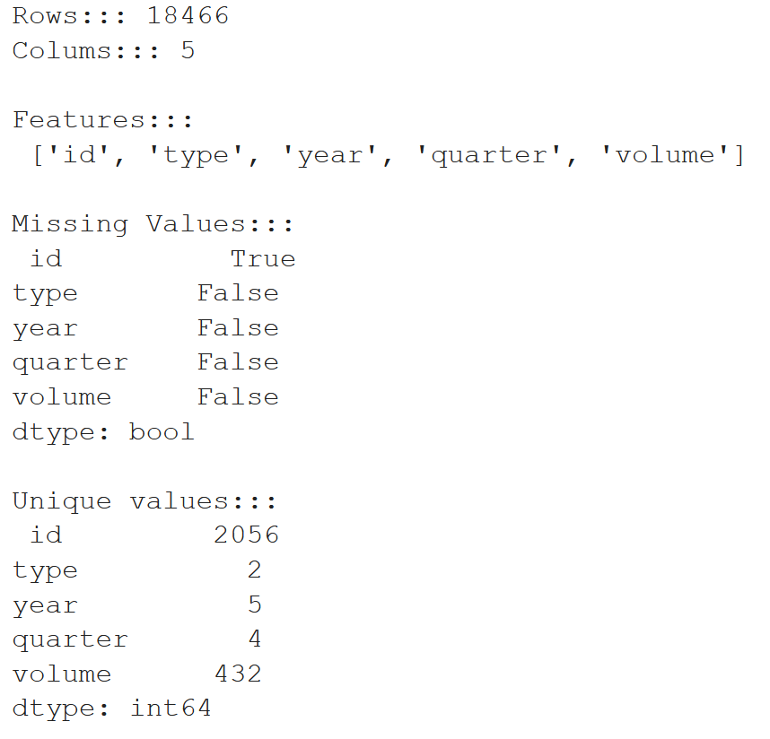
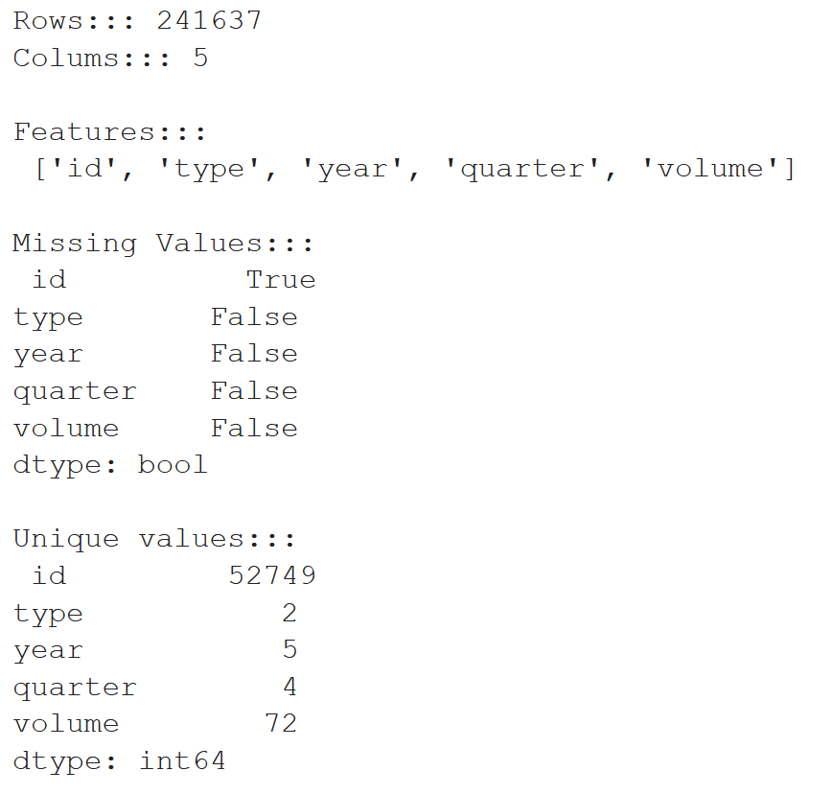
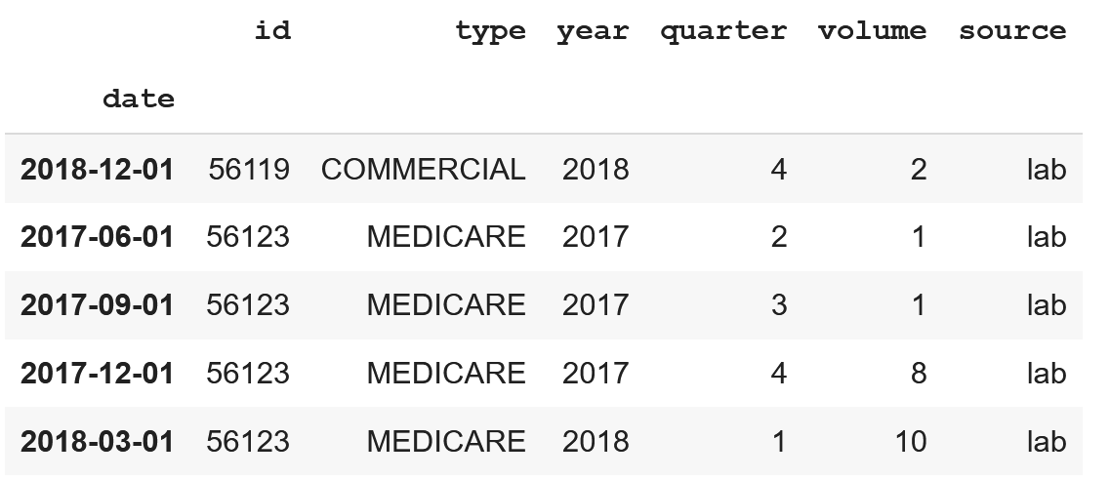
ETL (Extract Transform Load)
View of data Lab data
View of data Physician data
Feature Engineering
The NA values were seen only in ID column
The % of missing values were as below
Lab: 0.108% → 20 rows
Physician: 0.01% → 35 rows
Combined year and quarter column to a single Quarter start date column
Transformed column date to Index
Created a new Column “source” to represent the source of data either Lab or Physician
Combined Lab and Physician data to a single data frame
Identified total number of quarters, min date and max date

Slide 6
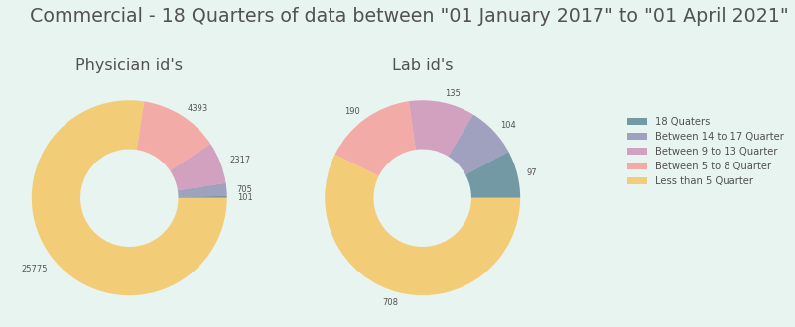
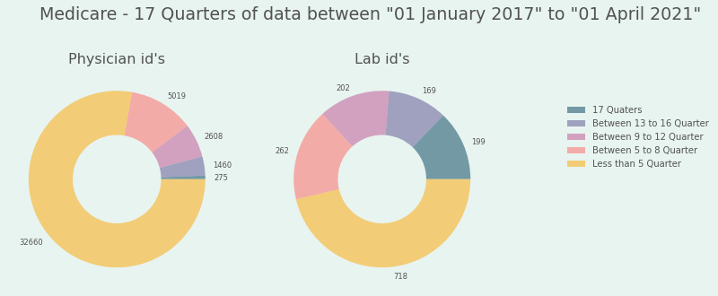
ETL (Quick look into the Data)
Lab / Physician
56119
Medicare
Commercial
56123
Source
ID of the referring physician
OR
ID of the lab
Insurance Type
Medicare
56126
Commercial
1003011339
Medicare
Commercial
Data for all years and Quarters
Data for all years and Quarters
2018Q1 & 2019Q4
Date and Quarter for which Volumes are available
2017Q2
2018Q4
2021Q2
…..
…..
…..

Slide 7
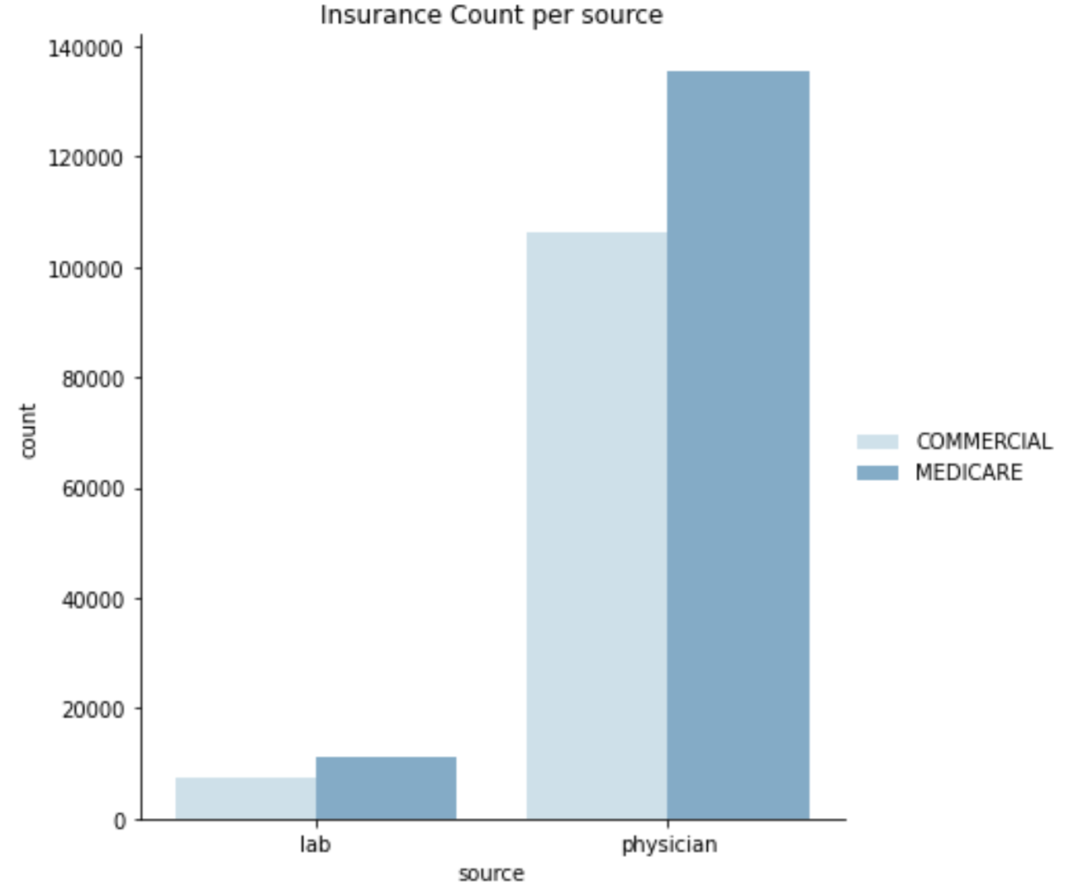
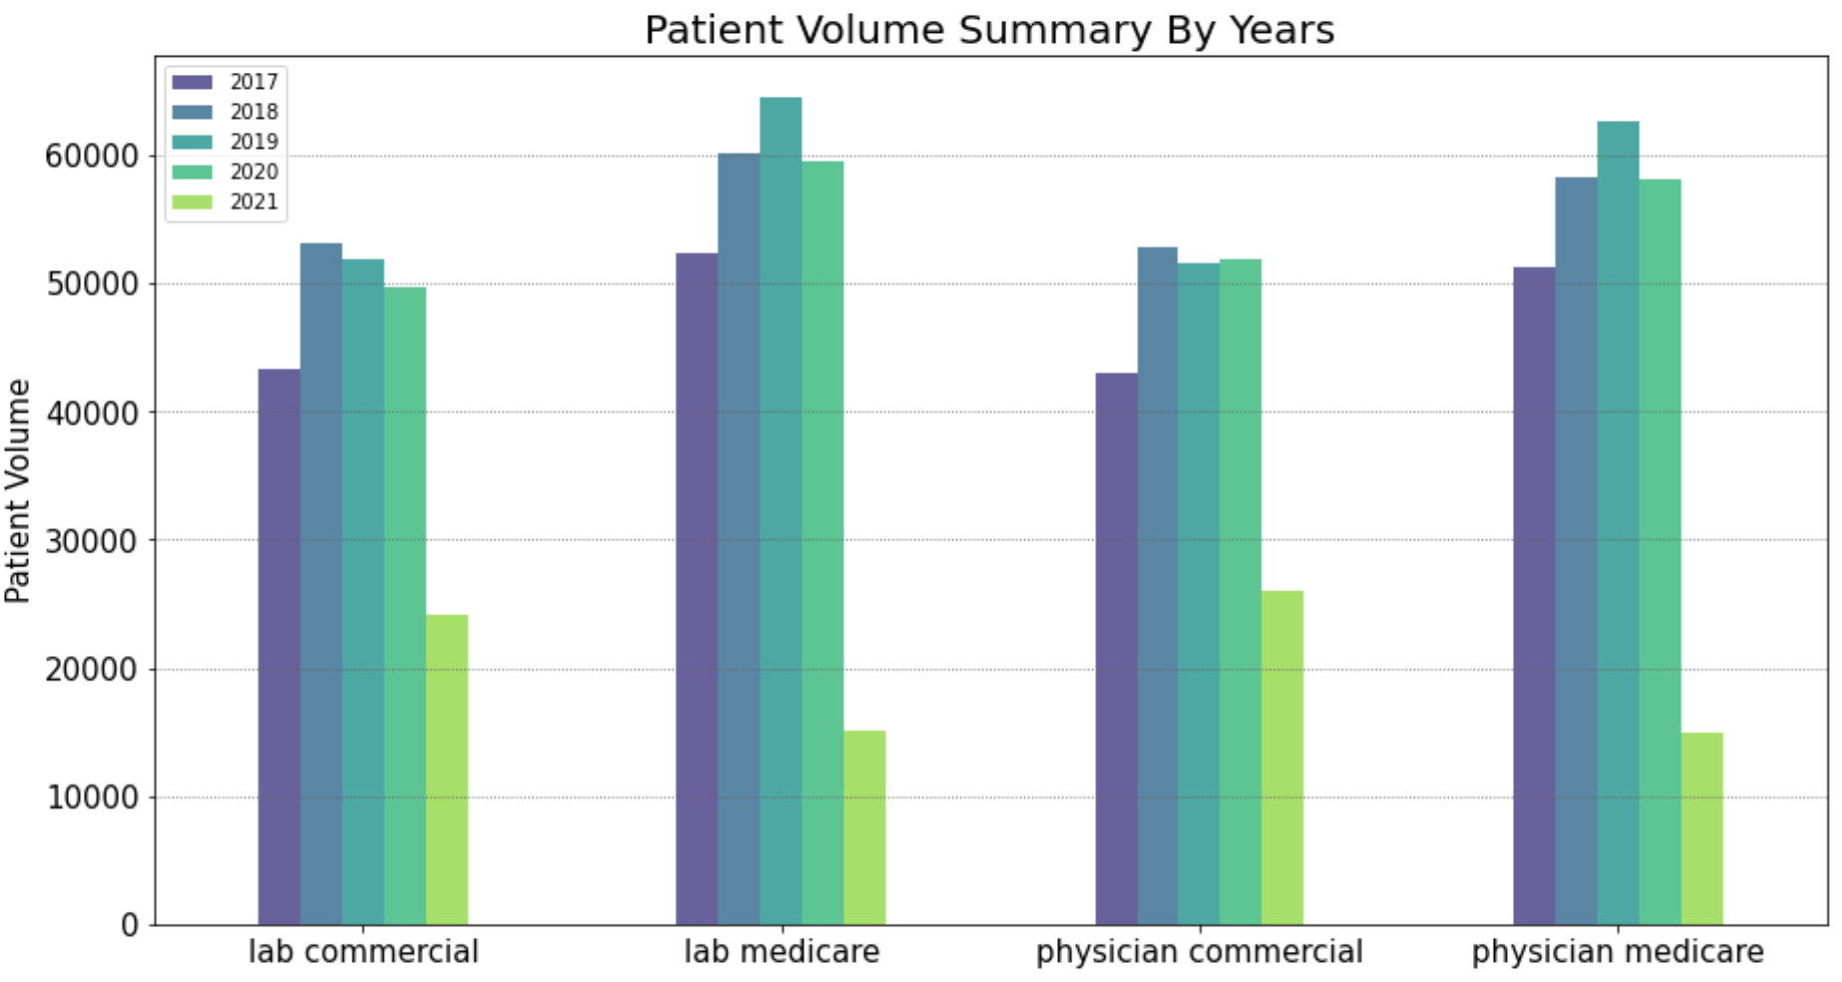
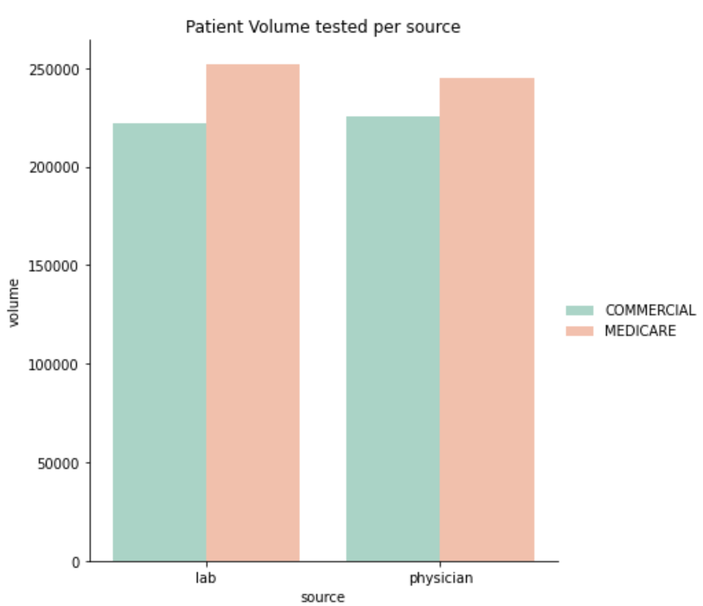
Exploratory Data Analysis
Total Id’s | Lab Id’s | Physician Id’s
54860 | 2076 | 52784

Slide 8
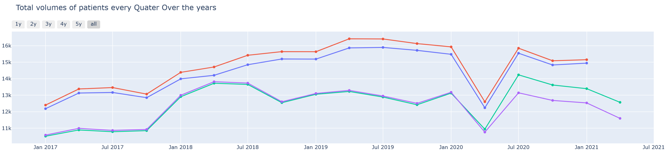
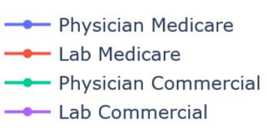
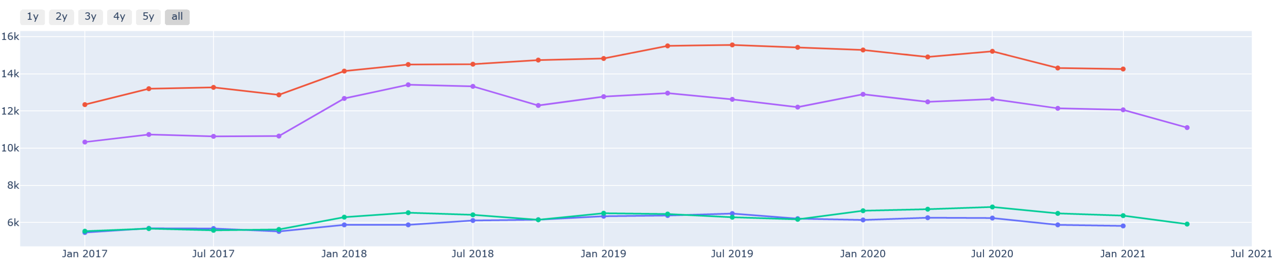
Exploratory Data Analysis Cont.…
Noise and Missing data Imputation Framework
Bad Data
Noise Removal for 100% available Time Series
Multiple Imputation techniques and there evaluation
Apply best Imputation technique for time series having >=75% and >=50% missing data.
Noise removal for >=75% and >=50% missing data Time series
Remove time series with <50% of missing data
Good Data

Slide 9
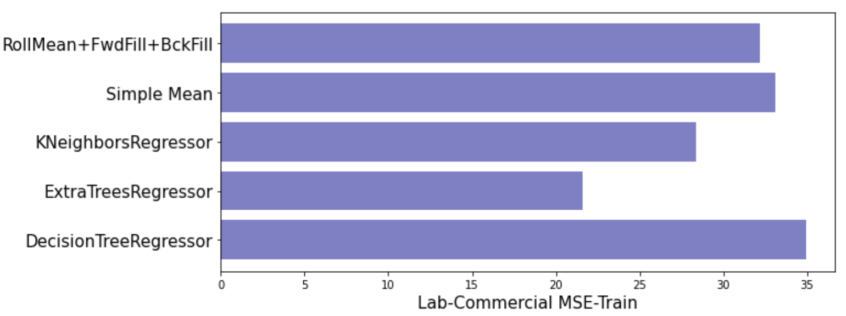
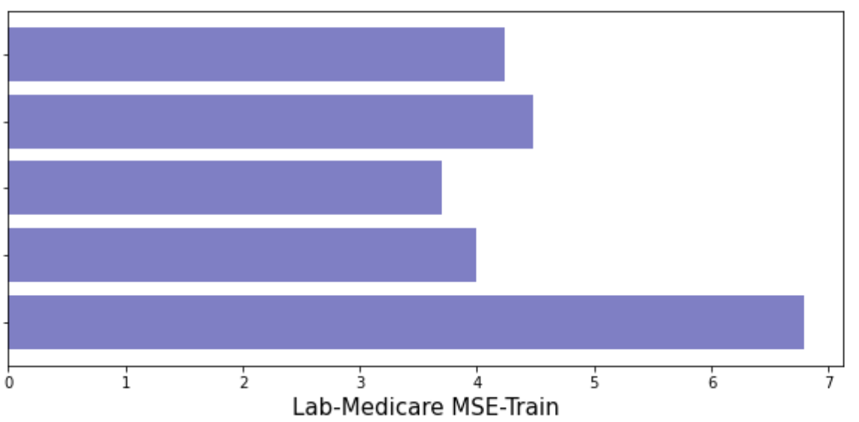
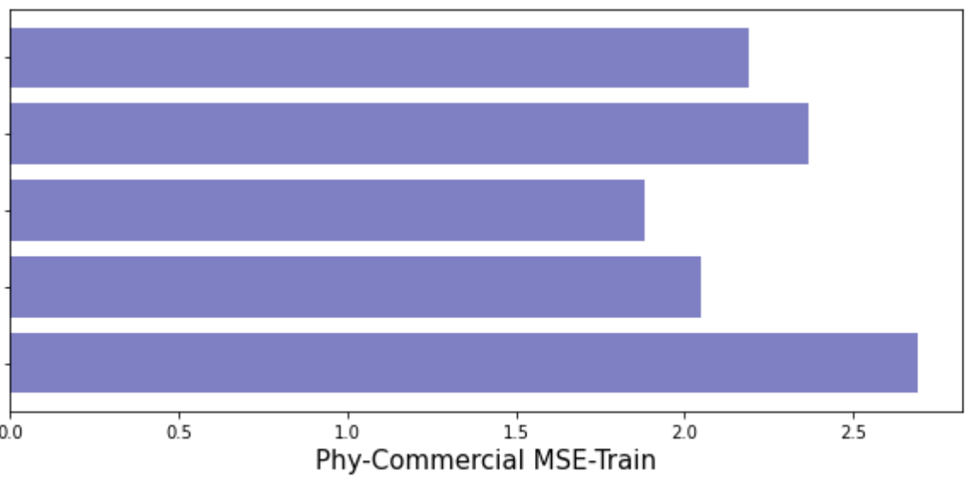
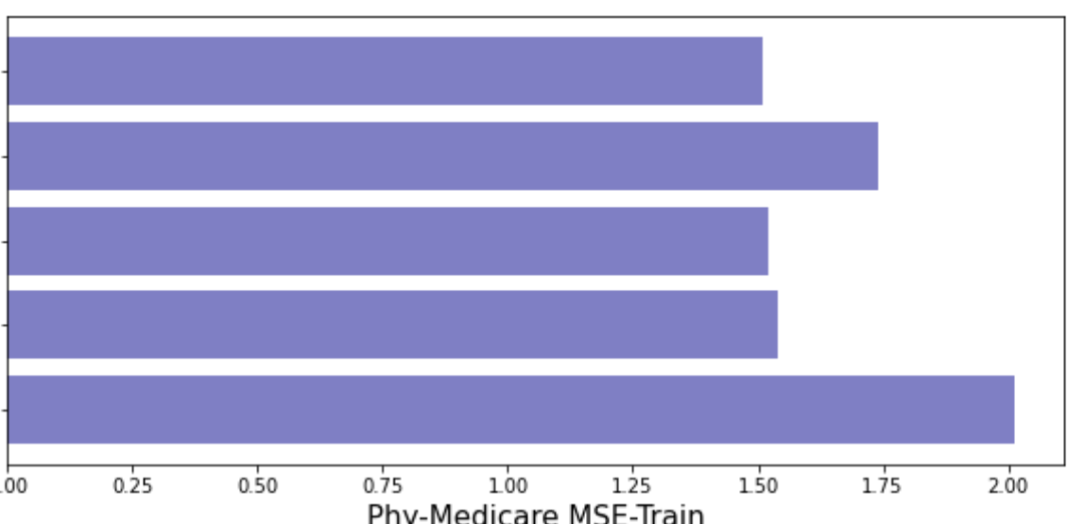
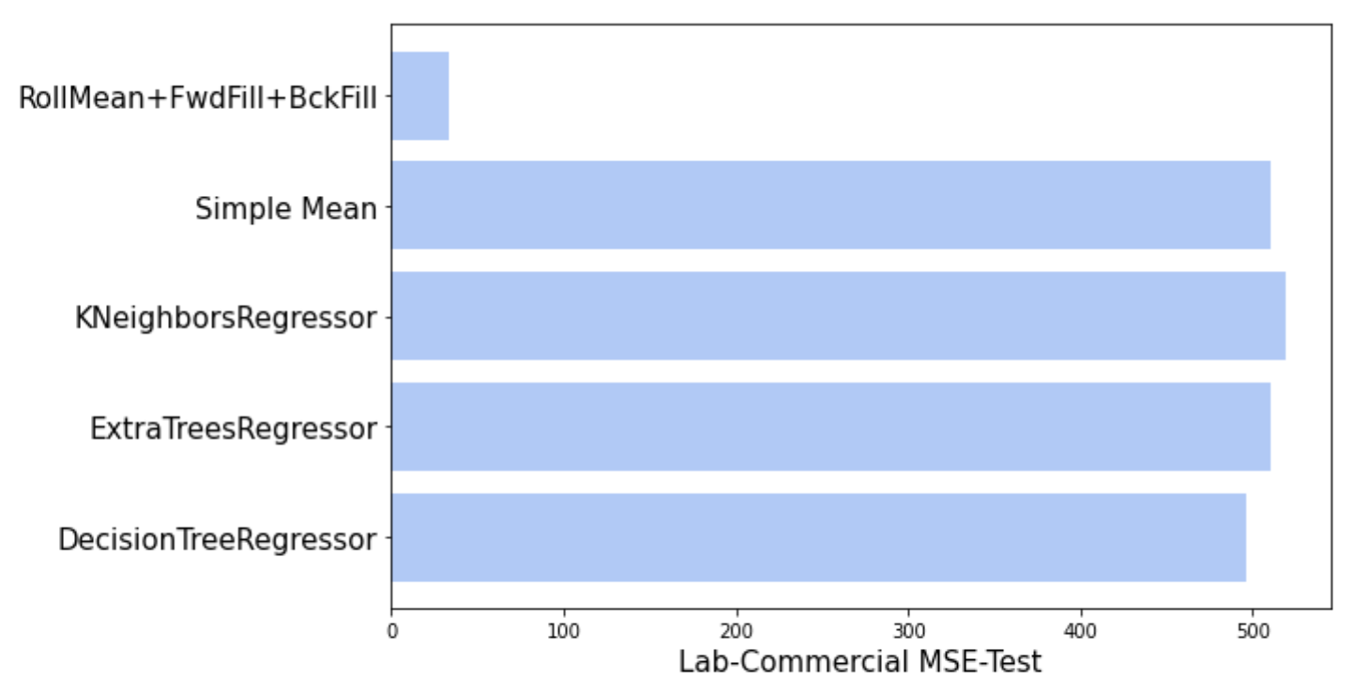
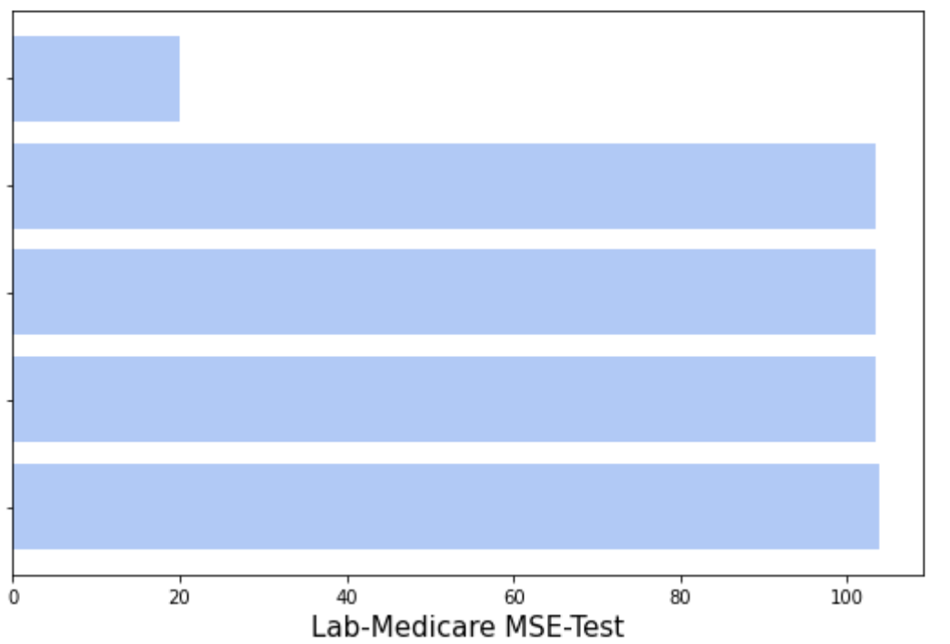
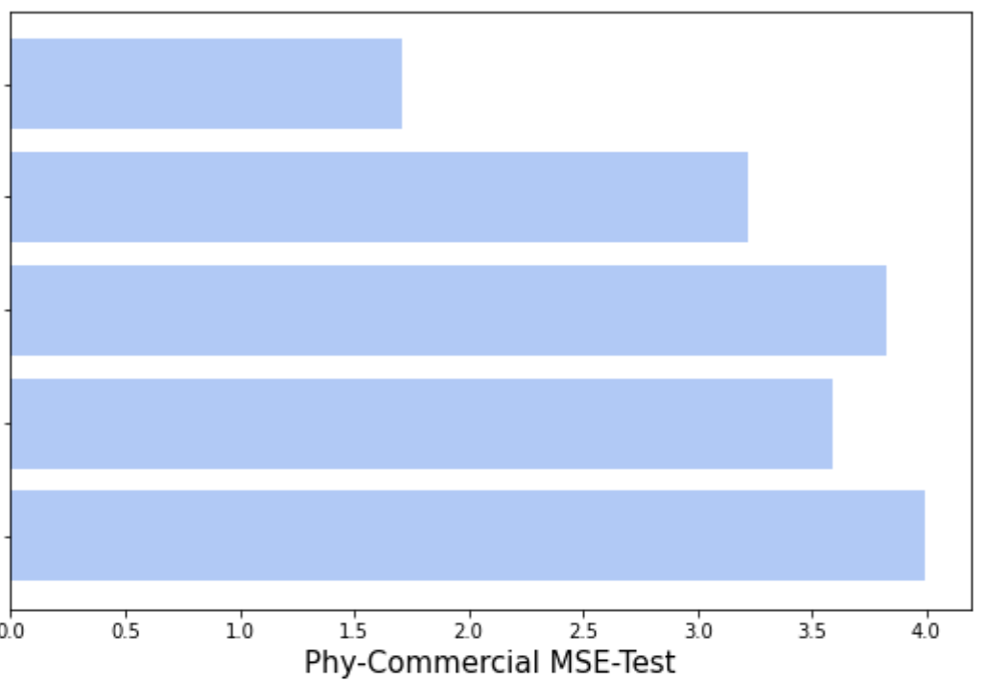
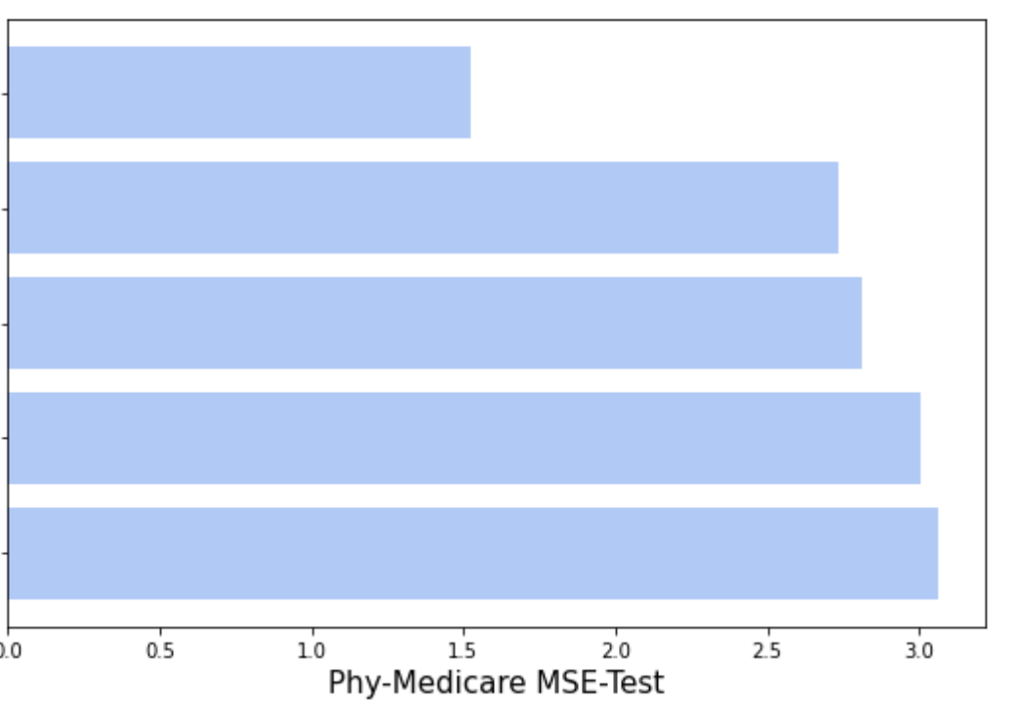
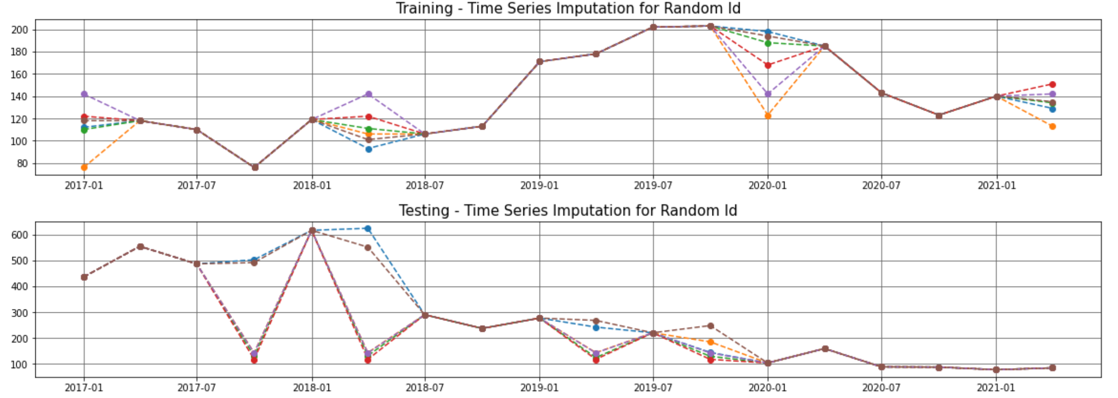
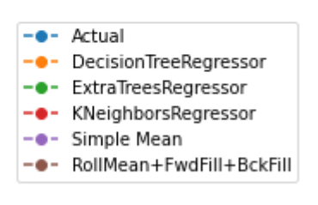
Exploratory Data Analysis Cont.…

Slide 10
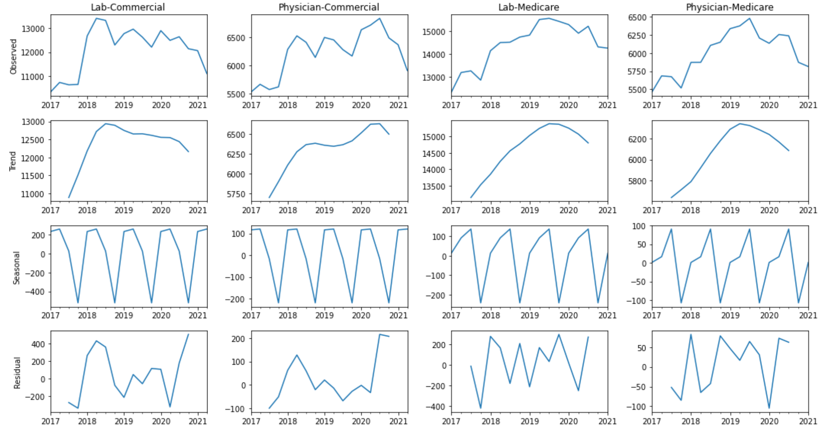
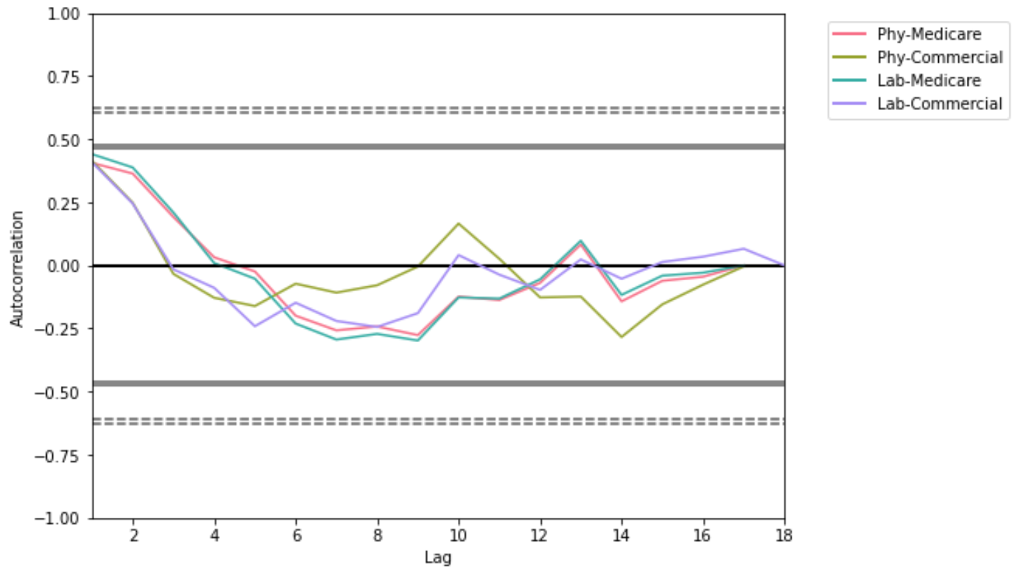
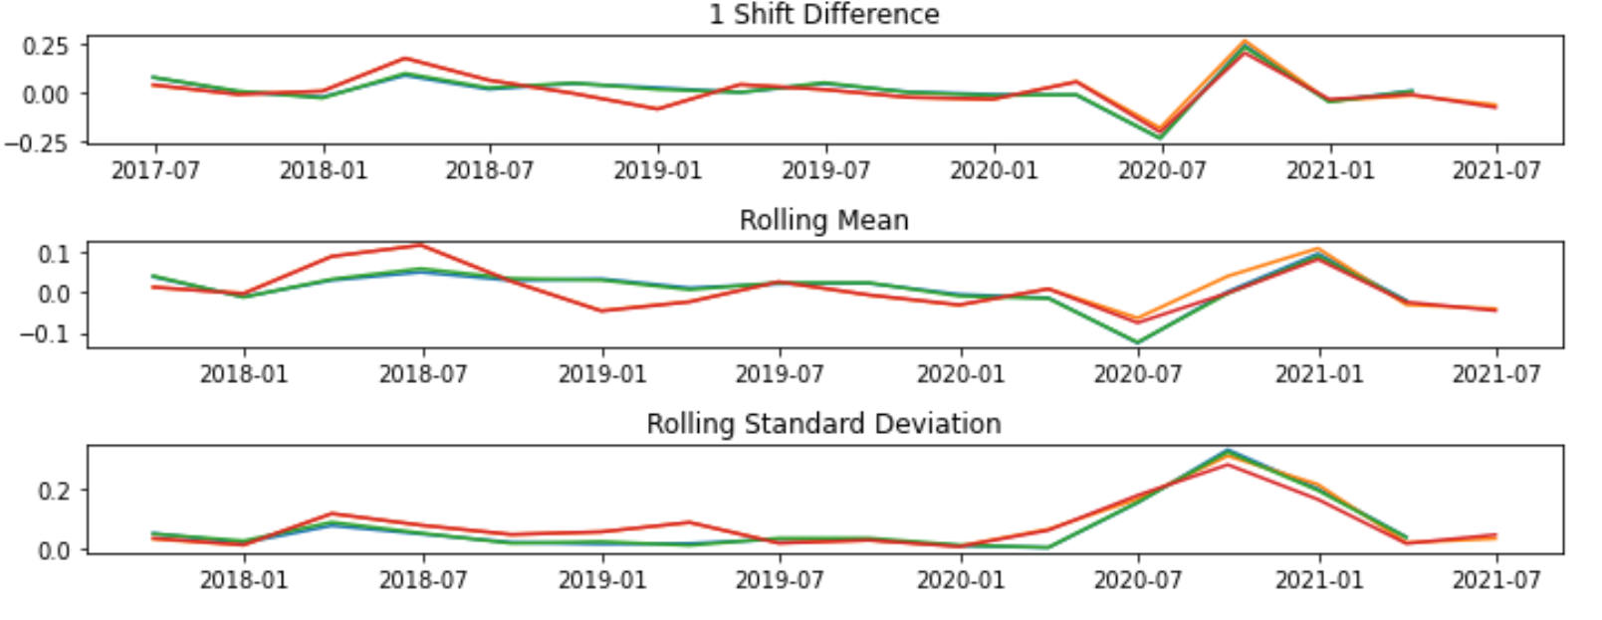
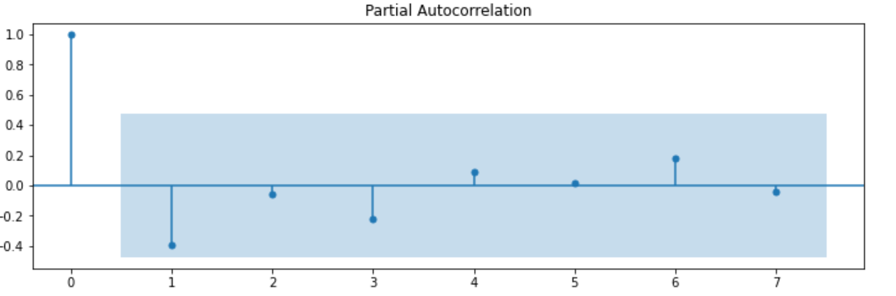
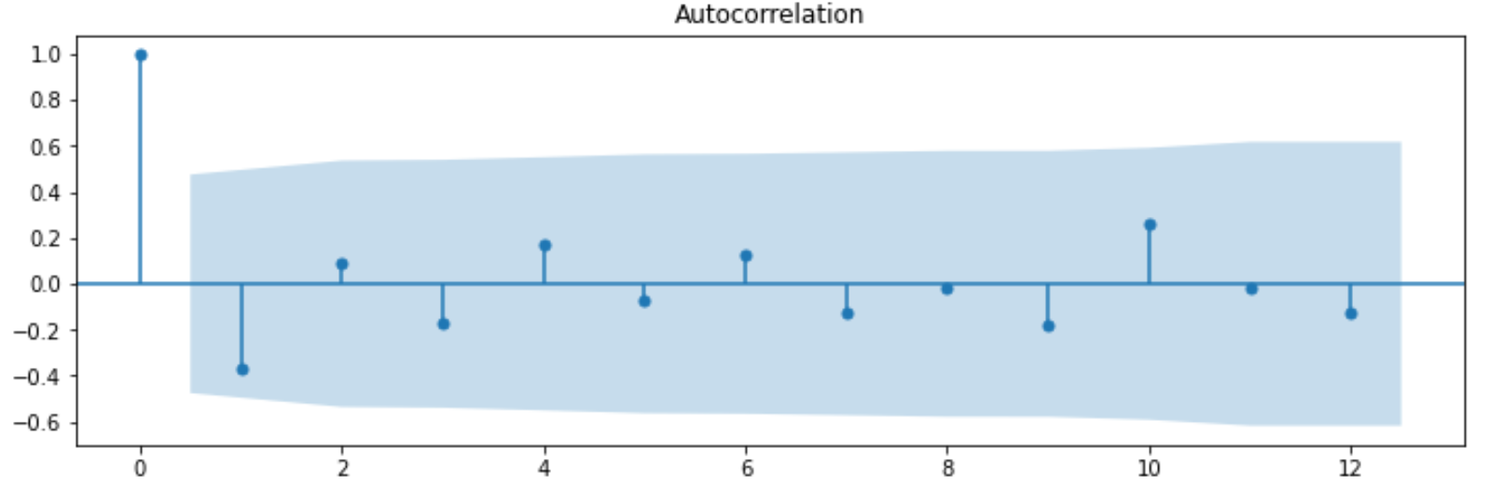
Exploratory Data Analysis Cont.…
1. DATA DECOMPOSITION
2. LAG AUTO CORRELATION
3. CONVERTING TO STATIONARY
4. ACF & PACF PLOTS

Slide 11
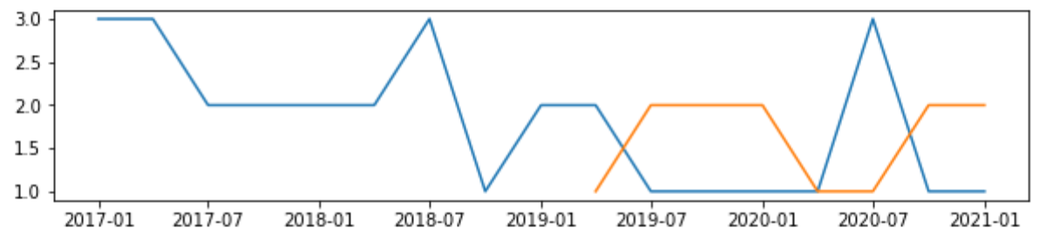
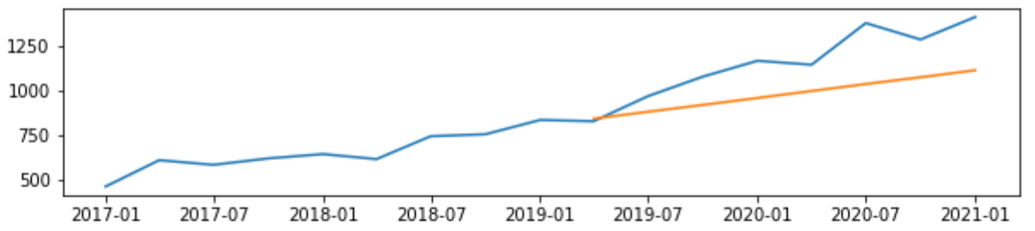
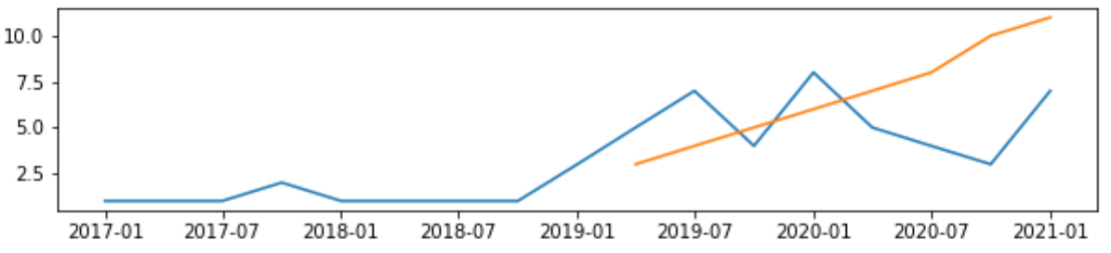
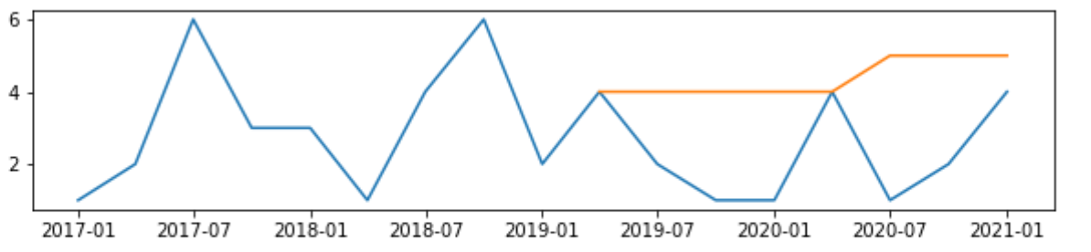
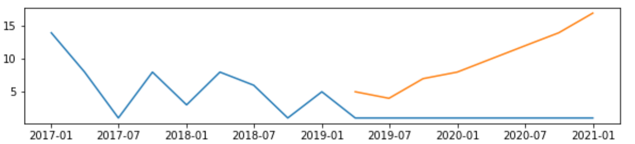
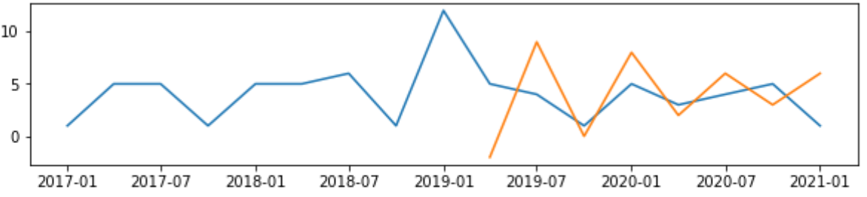
Modelling
Model 1 → Auto ARIMA:
Best Model: SARIMAX(4,1,1) - 57549
Best Model: SARIMAX(2,0,2) - 57549
Best Model: SARIMAX(1,1,0) - 59309
Best Model: SARIMAX(1,1,0) -1316011018
Best Model: SARIMAX(2,1,0) - 56622
Best Model: SARIMAX(1,1,0) -1023147014

Slide 12
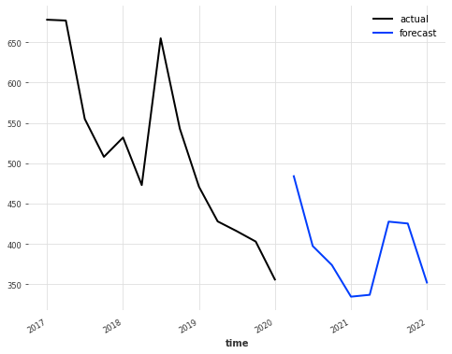
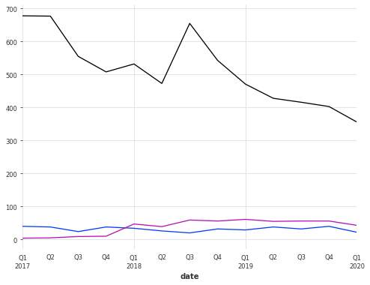
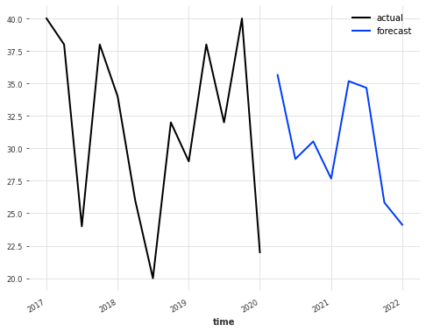
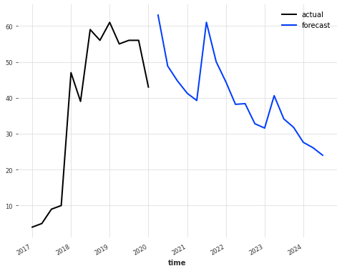
Modelling
Model 2 → N-BEATS: Neural basis expansion analysis for interpretable time series forecasting
Deep neural architecture based on backward and forward residual links and a very deep stack of fully-connected layers.

Slide 13
Future Scope
NBeats with Covariant dependencies, Prophet, RNN and Deep-AR
Hyper parameter tuning using Grid Search CV
Evaluating the best model
Integrate a Jupyter notebook in a KNIME workflow
Web application to Train the new data and Forecasting for the input provided.
Multiprocessing (Data Parallelism)

Slide 14
References
https://www.youtube.com/watch?v=UhxCsweuKE4
https://arxiv.org/abs/1905.10437 (Nbeats Research paper)
https://github.com/unit8co/darts
https://machinelearningmastery.com/time-series-forecasting-methods-in-python-cheat-sheet/?unapproved=627419&moderation-hash=561bee264f6075bd083bfbc9e96e3d5d#comment-627419
https://facebook.github.io/prophet/
https://unit8.co/resources/training-forecasting-models/
https://medium.com/sfu-cspmp/doppler-effect-hierarchical-time-series-forecast-for-apparel-industry-45a55bb23be6
https://medium.com/spikelab/forecasting-multiples-time-series-using-prophet-in-parallel-2515abd1a245
Code: https://github.com/AnjuBanu/Diaceutics

Slide 15

THANK
YOU

